Slide 1
Collaborative Work Effort to Improve Coordination of Benefits
For Medicare Hospice Beneficiaries

Slide 2
Issue & Goal
Issue: Part D Plans need to receive timely notification of enrollment in other Medicare coverages to ensure they are not paying for drugs that should be paid under a bundled payment and to reduce post-payment recoveries (burden for plans and hospices)
Goal: To minimize the number of drugs paid by Part D that should have been paid by Hospice by reducing the timeframe from Hospice election to notification to the Part D Plans

Slide 3
Stakeholders & Work
The Gold Standard for Collaboration
CMS
NCPDP
Hospice
Plan sponsors
Pharmacy
Hospice PBM or intermediary
Hospice EMRs
CMS/Transaction Facilitator
Clearinghouses (billing entity that generates 837I or feeds data directly to Direct Data Entry (DDE) System)
Hospice Pharmacies (Phase II)
This presentation is a culmination of over 7 years of learning and work, initiated following the first OIG report.

Slide 4
Context
1.55 million Medicare beneficiaries were enrolled in hospice care for one day or more in 2018.
50.7% of Medicare decedents were enrolled in hospice at the time of their deaths.
The average length of service for Medicare beneficiaries was 89.6 days, with the median length being 18 days.
  Source: MedPAC March 2020 Report to Congress
Part D plan notification delays:
  Average for one major Part D Parent Organization = 22 days
  Once Hospice submits NOE, significant delays in processing within CMS systems and notification to Part D Plan
Notes:
Mary/Judi

Slide 5
Examples of Delays
Hospice Admission | Hospice Submits Notice of Election to CWF* | Hospice TRR to Plan | Hospice Enrollment Data Loaded at PBM | Days Part D processes Part A drugs
01/13/2019 | 1/18/2019 | 02/28/2019 | 03/01/2019 | 46
09/04/2019 | 9/9/2019 | 09/19/2019 | 09/20/2019 | 16
07/03/2019 | 7/8/2019 | 07/24/2019 | 07/25/2019 | 22
08/27/2019 | 9/1/2019 | 10/01/2019 | 10/01/2019 | 35
08/31/2019 | 9/5/2019 | 11/04/2019 | 11/04/2019 | 65
*calculated based off admission date

Slide 6
Hospice Required Notifications
To CMS via Claims or Direct Data Entry (DDE)
  Admission / Transfer-in
  Discharge / Revocation
To Others
  PBM via defined process
  Long Term Care Pharmacy via defined process
  Patient or other providers via Patient Notification of Non-Covered Services Addendum (Required as of 10-01-2020)*
  Part D Plan Sponsor via A3 – Hospice Information for Medicare Part D Plans (Paper form developed by NCPDP Hospice Task Group)
See Hospice workflow at end of presentation for details on current process
*currently proposed as a manual process
Notes:
Judi

Slide 7
5 Day Notification Requirement
Admission/Transfer In
Collect patient information
Initial assessment
Patient consent if new pt.
Discharge Process
Live discharge (Patient or Hospice initiated)
Transfer out
Death
CMS Notified via DDE or 837I
Admission (NOE w/in 5 days)
Transfer in (NOC when system allows)
CMS Notified via DDE or 837I
Live discharge (NOTR w/in 5 days)
Transfer out (Final claim)*
Death (Final claim)*
*5 day requirement does not apply

Slide 8
Current CMS Reporting Barriers
CMS does not return validation to Hospice provider that the actual beneficiary enrollment has been accepted and processed through CMS systems. DDE system is used to validate but creates a separate workflow
Some EMRs have created a way to validate within their systems
Clearinghouses have created solutions for DDE access to simplify the process
Notes:
Judi

Slide 9
Proposed Process
Establish transmission between the Hospice EMR and the Transaction Facilitator
The Transaction Facilitator would send the data to the Part D Plan
An 835/response-like process is needed for this new process.
  Beneficiary was matched
  Forwarded to Part D plan
  Part D accepted bene info
Notes:
Monique

Slide 10
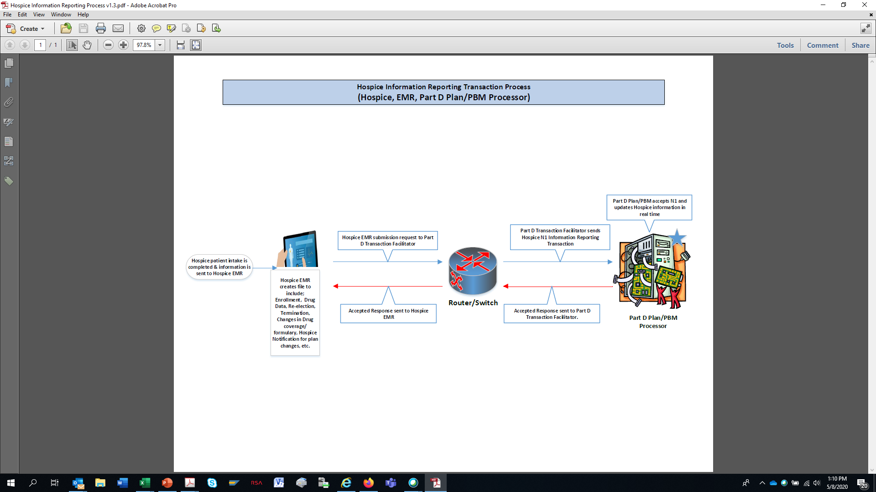
Plan Notification for Hospice and Other Coverage Phase I

Slide 11
Phase I – Enrollment / Election
Need to expedite transmission of information from hospice to Part D plan sponsors and not be hindered by CWF delays
Part D plan sponsors need the following:
  Facility information (NPI)
  Demographics (MBI, Last Name, First Name, DOB)
  Election date – NOE (81A or 82A)
  Transfer date – NOC (81C or 82C)
  Termination date – NOTR (81B or 82B)
  Termination reason (814 or 824)
8xx identifies the type of bill (current CMS transaction set) from Hospice to CMS
Notes:
Monique

Slide 12
Termination Reasons and Part D Example Edits
Beneficiary that is deceased will result in all claims being denied – no more coverage (814 or 824)
Beneficiary that is transferring
  Should continue negative PA for up to xx days or until new Hospice is identified and plan can confirm drugs
  If receiving Hospice does not submit a new admission transfer date (NOC 81C or 82C) within xx days, then plan should remove negative PA
If beneficiary revokes election or Hospice discharges (NOTR 81 B or 82B), plan should remove negative PA
Notes:
Monique

Slide 13
Phase II
Drug information
  Related to terminal condition
  Not related to terminal condition
  Patient responsibility
  EMRs may not have NDC level data – only drug name, strength and dosage
  NDC, quantity dispensed and days supply (if available)
Diagnosis codes
Prescriber information
Notes:
Monique

Slide 14
Beneficiary Identification
Very likely that Hospice does not know what Part D plan the beneficiary is enrolled in
EMR will send Medicare Beneficiary Identifier (MBI)
Transaction Facilitator will identify beneficiary and collect Part D Plan transaction routing information 4RX (BIN/PCN/Group/Cardholder ID)
Transaction Facilitator will send MBI and 4Rx to Part D Plan. Information reporting transactions currently use 4Rx for matching in Plan system.
Notes:
Monique

Slide 15
Data Formatting
Medical world and pharmacy world use different transaction/communication standards
Data from EMR will need to be translated from Medical (X12) to Pharmacy (NCPDP Information Reporting (Nx))
Need to determine transmission mechanisms between EMR and Transaction Facilitator (new channel)
Notes:
Monique

Slide 16
Validation Approach
Beta test first
  Identify one EMR that services beneficiaries within a Part D Plan’s coverage area to test process
  Hospice provider(s)
  Part D plan(s)
Notes:
Monique

Slide 17
Outside of Scope
NOE/NOTR/NOC transmission for MACs due to concerns related to payments
Notification to MA only plans (no current connection to Transaction Facilitation or NCPDP ability)
Hospice providers that enter election information manually into Direct Data Entry (DDE) and do not have the ability to generate an 837I claim transaction standard
Notes:
Mary/Nancy

Slide 18
Task Group Request
Utilize this approach to solve for the lag time in notifying the Part D Plan
CMS support work effort of task group
CMS communicate work effort to Hospices and Part D sponsors
CMS modify their transaction process to create a response from the CWF after processing that contains beneficiary level acceptance/rejection/processing for any NOE/NOC/NOTR 837I that is submitted by a Hospice provider
Reduce the burden on hospice providers
Notes:
Mary/Nancy

Slide 19
Task Group Request
Consider the possibility of using one transmission for notification of both CMS and the Transaction Facilitator (if billing issue can be addressed)
Standardize all collected data elements in a manner that data can be used for future electronic use. For example:
  Standard reason codes
  No free form text
  ICD codes instead of written diagnoses
  Match field counts available between transactions and required documentation (addendum)
Do away with transfers. No mechanism for Hospice to notify CMS about a transfer other than a final claim. Use discharge only.
Address common working file inadequacies related to information sharing.

Slide 20
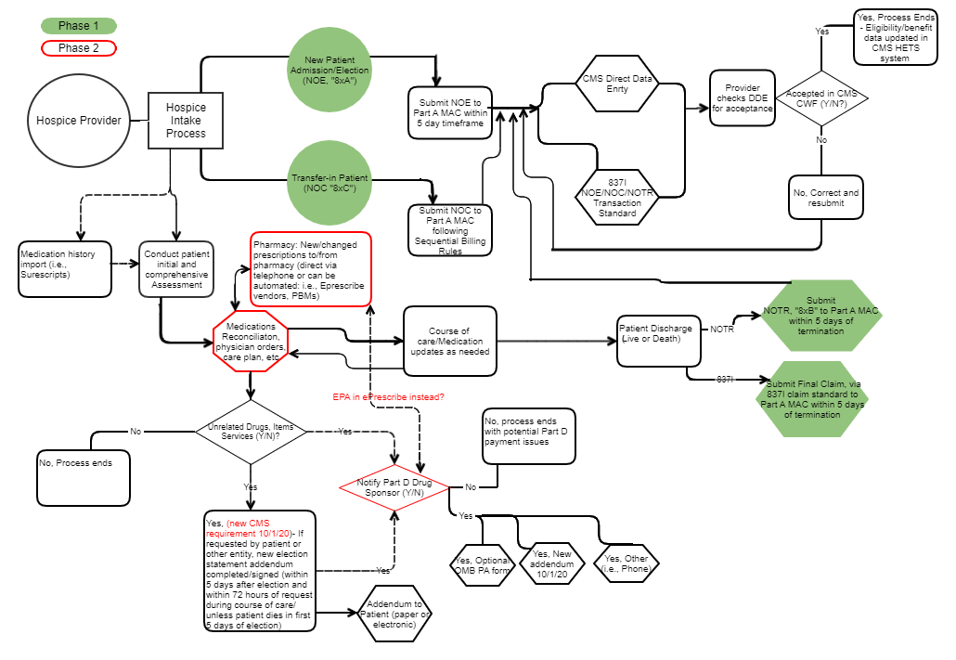
Hospice work flow
Notes:
Judi

Slide 21

Thank you for your time!

